Slide 1

Project 4 – Predicting Employee Attrition
Ayesha Maryam, Athul Madhusudhanan, Mujahid Iqbal, Edward Vaughan, Daniel Daniel

Slide 2
Background

Slide 3
Data Source
IBM HR Analytics Employee Attrition & Performance
From IBM
Sourced from Kaggle: https://www.kaggle.com/datasets/pavansubhasht/ibm-hr-analytics-attrition-dataset/discussion/233758
Wide variety of metrics to analyse
1470 records

Slide 4
Data Importing

Slide 5

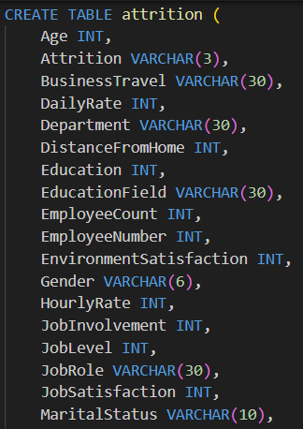
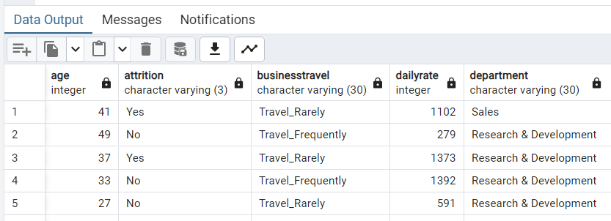
PostgreSQL

Slide 6

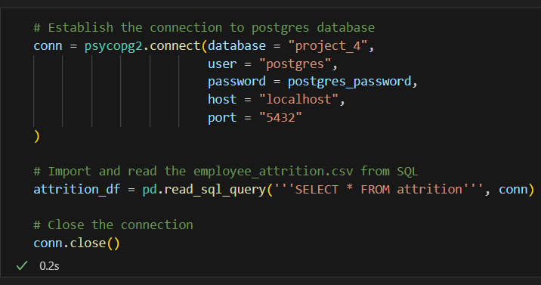
Psycopg2
Database connection established.
SQL query executed, and DataFrame created.
Connection closed at the end.

Slide 7
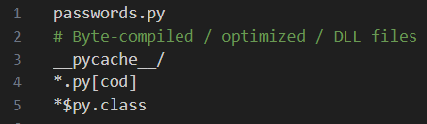
gitignore
File containing postgres password (passwords.py) added to gitignore.

Slide 8
Data Preprocessing

Slide 9
Input Data
Column Names | Description
Age, Gender, MaritalStatus, Over18
Attrition
BusinessTravel, DistanceFromHome
DailyRate, HourlyRate, MonthlyRate
Department, JobLevel, JobRole
Education, EducationField
EmployeeCount
EmployeeNumber
EnvironmentSatisfaction
JobInvolvement
JobSatisfaction
MonthlyIncome
NumCompaniesWorked
OverTime
PercentSalaryHike
PerformanceRating
RelationshipSatisfaction
StandardHours
StockOptionLevel
TotalWorkingYears
TrainingTimesLastYear
WorkLifeBalance
YearsAtCompany, YearsInCurrentRole, YearsSinceLastPromotion
YearsWithCurrManager

Slide 10
Features and Targets
Make label the attrition column, convert Yes/No columns to 1/0 columns and then drop attrition column from features
y = attrition_data_df ('Attrition')
y = y.apply (lambda x: 1 if x == 'Yes else 0)
X = attrition_data_df.drop ('Attrition', axis = 1)

Slide 11
Split the data
from sklearn.model_selection import train_test_split
from sklearn.preprocessing import LabelEncoder
lc = LabelEncoder ()
for col in X.columns:
if X [col].dtype == 'object':
X [col] = lc.fit_transform (X [col]
X_train, X_test, y_train, y_test = train_test_split (X, y, random_state = 165)
from sklearn.linear_model import LogisticRegression
classifier = LogisticRegression (solver = 'lbfgs', random_state = 165)
classifier_fit (X_train, y_train)

Slide 12
Logistic Regression Model

Slide 13
Predictions
predictions = classifier.predict (X_test)

Slide 14
Evaluation

Slide 15
Confusion Matrix
from sklearn.svm import SVC
confusion_matrix (y_test, predictions)
Array ([[317, 0].
[ 50, 1]])

Slide 16
Classification Report
target_names = ['Attrition', 'No Attrition']
print (classification_report (y_test, predictions, target_names = target_names))
precision recall f1-score support
Attrition 0.86 1.00 0.93 317
No Attrition 1.00 0.02 0.04 51
accuracy 0.86 368
macro avg 0.93 0.51 0.48 368
weighted avg 0.88 0.86 0.80 368

Slide 17
Optimisation

Slide 18
Summary
From the confusion matrix, the classifier does very well on no attrition, correctly labelling all the samples. It does less well on attrition, getting all but one wrong.
From the classification report, the precision (the ability of a classifier not to label a negative sample as positive) is good for both attrition and no attrition. The recall (the ability of a classifier to find all the positive samples) is good for attrition but bad for no attrition.

